Slide 1


Slide 2
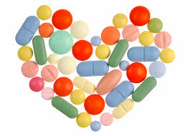
Beta Blocker Poisoning

Slide 3
Dr. Afshin Gharekhani
PharmD, BCPS
Assistant Professor of Clinical Pharmacy,
Department of Clinical Pharmacy,
Tabriz University of Medical Sciences

Slide 4
Beta blockers have been in clinical use for more than 30 years:
  Hypertension
  Ischemic heart disease
  Heart failure
  Arrhythmias
  Migraine headache
  Tremor
  Portal hypertension
  Aortic dissection
Although safe for most patients when taken as prescribed, beta blocker toxicity is associated with significant morbidity and mortality.
Complications following beta blocker overdose are related to excessive beta adrenergic blockade, and occasionally the
proarrhythmic (membrane-stabilizing) activity of these agents on cardiac conduction.
Common and potentially dangerous co-ingestions (increases mortality):CCBs, cyclic antidepressants, and neuroleptics.

Slide 5
Pharmacology
Receptor types and general mechanism:
  Beta 1 (primarily in heart muscle): an increase in heart rate,
  contractility, AV conduction, and a decrease in AV node refractoriness
  Beta 2 (heart muscle but more prominent in bronchial and peripheral vascular smooth muscle): results in vasodilation and bronchodilation.
  Beta 3 (adipose tissue and the heart): may mediate catecholamine induced thermogenesis and may reduce cardiac contractility.
  Beta-1 selective blockade results in depressed myocardial contractility, decreased automaticity in pacemaker cells, and decreased conduction velocity through the AV node.
  The lungs, peripheral blood vessels, glucose metabolism, and CNS are all affected by beta blockade.
  Nonselective beta blockade results in systemic effects including bronchoconstriction, impaired gluconeogenesis, and decreased insulin release.

Slide 6
Cellular Toxicity
Three properties that affect beta blocker toxicity:
  Membrane stabilizing activity (MSA): inhibit myocardial fast sodium channels, which can result in a widened QRS interval and may potentiate other dysrhythmias. Acebutolol, Betaxolol, Carvedilol, Oxprenolol, Propranolol.
  Lipophilicity: Beta blockers with high lipid solubility rapidly cross the BBB into the CNS, predisposing to neurologic sequelae such as seizures and delirium. Carvedilol, Nebivolol, Penbutolol,Propranolol, Bisoprolol, Labetalol, Metoprolol, Oxprenolol, Pindolol, Timolol.
  Intrinsic Sympathomimetic Activity(ISA): a partial agonist effect at the beta receptor site, resulting in less bradycardia and hypotension in therapeutic and supratherapeutic doses. Bronchoconstriction is less likely with ISA, or beta-1 selectivity.
  Acebutolol, Carteolol, Labetalol (β₂), Oxprenolol, Pindolol, Penbutolol
  “However, the protective effects of ISA do not completely prevent cardiovascular toxicity following intentional or accidental overdose”

Slide 7
Toxicity of Specific Agents
Of all the variables contributing to toxicity, MSA appears to have the greatest influence on adverse cardiovascular effects.
Agents with significant MSA: Propranolol, Acebutolol, Betaxolol, and Oxprenolol.
Acebutolol, a cardioselective agent with partial agonist activity and significant MSA, is one of the most toxic beta blockers in overdose. Acebutolol toxicity may predispose the patient to ventricular repolarization resulting in arrhythmias.
Carvedilol has been associated with toxic epidermal necrolysis at therapeutic levels.

Slide 8
Pharmacokinetics

Slide 9
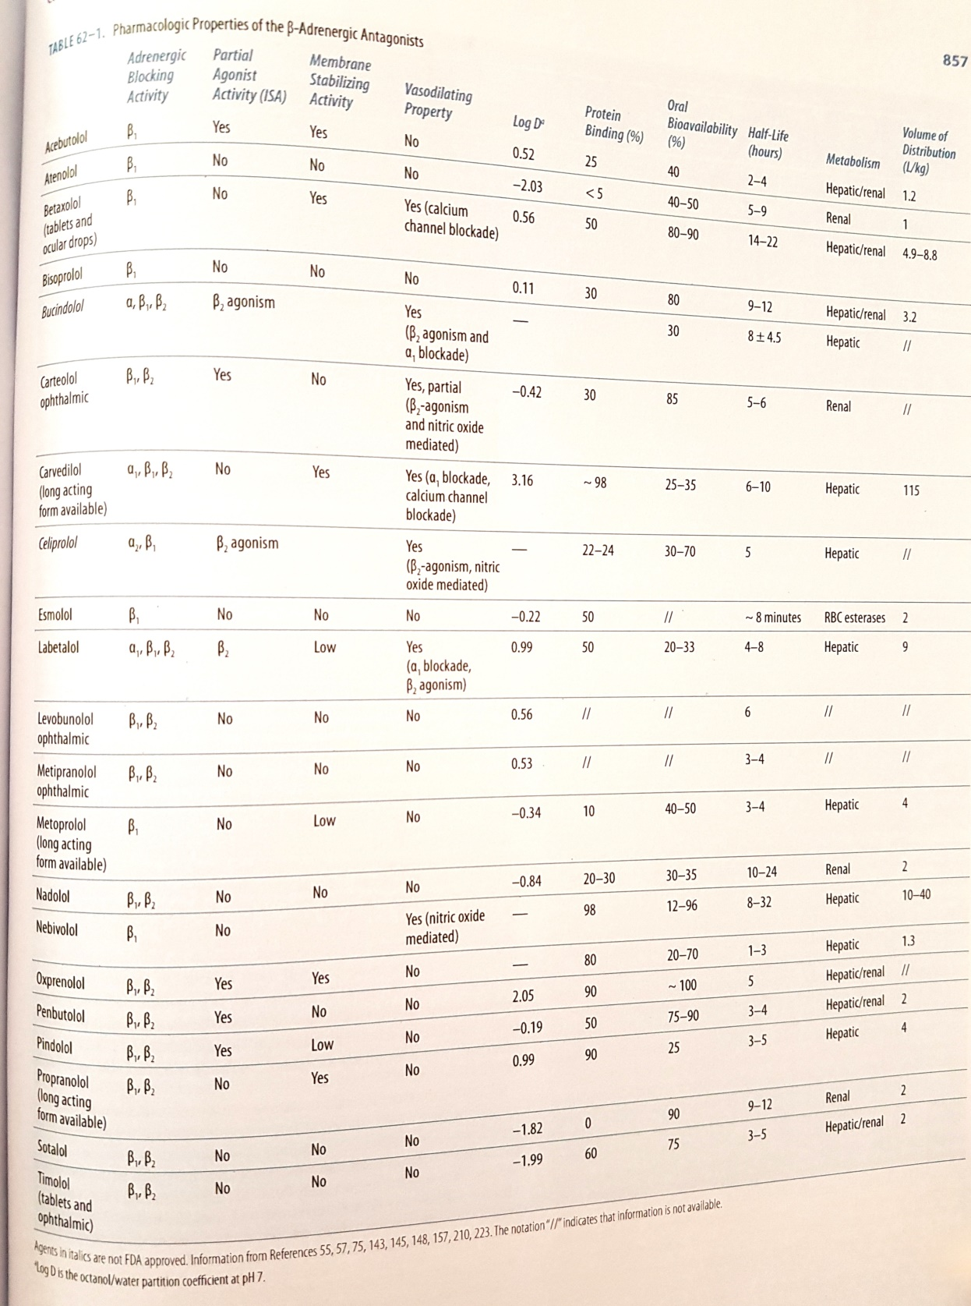

Slide 10
Clinical Features of Overdose
History:
  Specific agent, amount ingested, time of ingestion, and any coingestions
  Historical features suggesting increased risk for severe toxicity:
    Coingestion of other cardioactive agents
    Underlying cardiac disease (eg, heart failure)
    Ingestion of sotalol or another agent with MSA
  Any possible witnesses and emergency medical services (EMS) personnel who may have recovered pill bottles at the scene should be contacted.
  The patient's pharmacy may provide valuable information regarding prescribed medications, the date of the most recent refill, and the total number of pills dispensed.

Slide 11
Physical findings:
  Most patients with beta blocker overdose become symptomatic within 2hr following ingestion, and nearly all develop symptoms within 6hr. Exceptions include ingestions of sustained release medications and sotalol. In these cases, delayed toxicity up to 24hr after ingestion can occur.
  Bradycardia, hypotension and in severe overdoses profound myocardial depression and cardiogenic shock occur.
  Ventricular dysrhythmias more frequently following propranolol and acebutolol exposures, probably due to the increased MSA of these agents.
  Other potential effects of severe toxicity: mental status change (delirium, coma, and seizures), hypoglycemia, and bronchospasm
  Propranolol is associated with neurologic effects in the absence of cerebral hypoperfusion, due to increased lipophilicity allowing rapid diffusion into the CNS.

Slide 12
Laboratory Evaluation
Laboratory studies:
  ECG (PR prolongation, bradycardia, QRS prolongation particularly with MSA, significant QTc prolongation following sotalol overdose, any bradydysrhythmia with progression to asystole in severe poisoning)
  Fingerstick glucose
  Glucose and potassium levels must be measured every 30 to 60 minutes if an insulin/glucose treatment regimen is used.
  Serum electrolytes including calcium (Q4-6h if Ca administered)
  BUN, Cr
  Pregnancy test in women of childbearing age
  Routine laboratory evaluation of acetaminophen and salicylate levels (to rule out these common coingestions).
  Additional tests based upon clinical findings (e.g. a plain chest radiograph in patients with signs of pulmonary edema)

Slide 13
Diagnosis
The diagnosis of beta blocker poisoning is made clinically on the basis of the history and clinical presentation.
Typically there is a history of overdose combined with findings of bradycardia and hypotension, which can be profound in severe overdose, resulting in cardiogenic shock.
Other findings can include ventricular dysrhythmia, altered mental status, seizure, hypoglycemia, and bronchospasm.
Although serum concentrations of most beta blockers can be measured, such measurements cannot be obtained in time to be clinically useful.

Slide 14
Differential Diagnosis
Many drugs can cause profound hypotension or bradydysrhythmia in overdose
CCBs, digoxin, clonidine, and cholinergic agents must be considered when evaluating bradydysrhythmia potentially caused by a toxic ingestion.
CCBs are less likely than beta blockers to produce alterations in mental status unless the patient is in profound shock.
Hyperglycemia occurs more often with CCB toxicity while beta blockers are associated with hypoglycemia.
Nausea and vomiting occur more often with digoxin toxicity than beta blocker toxicity. Digoxin may cause characteristic changes in an ECG such as scooped ST segment depressions. Digoxin is more likely to produce rhythms of increased automaticity, such as atrial tachycardia with AV block, premature ventricular contractions, or ventricular arrhythmias.
Clonidine produces a constellation of signs that can resemble opioid overdose, including somnolence and miosis, but are accompanied by hypotension and bradycardia.
Overdose of a cholinergic agent can present with bradycardia but also includes other characteristic features (salivation, lacrimation, urination, defecation, GI upset, and muscle excitability).

Slide 15
Management

Slide 16
Acute stabilization and overview of therapy
Secure the airway and provide advanced cardiac life support as necessary.
Atropine (0.5 to 1 mg every three to five minutes up to a total of 0.03 to 0.04 mg/kg) should be given early in bradycardic patients and as a pretreatment agent when rapid sequence intubation is required
Establish IV access and provide continuous cardiac monitoring.
Treat hypotension with IV boluses of isotonic fluid; treat symptomatic bradycardia with atropine.
Sodium bicarbonate and magnesium may be needed to treat some arrhythmias
Treat symptomatic hypoglycemia with IV dextrose.
Treat seizures with benzodiazepines (eg, lorazepam)
IV fluid and atropine often do not completely reverse the cardiotoxic effects of beta blocker overdose. Give additional treatments based upon the severity of the presentation:
  IV glucagon
  IV calcium salts
  Vasopressor
  High dose insulin and glucose infusions
  Lipid emulsion therapy

Slide 17
Selection of Specific Therapies based on the severity of the clinical presentation
Patients manifesting signs of severe beta blocker poisoning (profound hypotension and/or severe bradycardia, depressed mental status):
  Multiple simultaneous interventions, including all of the following treatments
    Stabilization of the airway as necessary (avoid induction agents that exacerbate hypotension)
    Additional IV boluses of isotonic crystalloid
    IV glucagon
    IV calcium salts
    IV vasopressor (eg, epinephrine)
    IV high-dose insulin and glucose
    IV lipid emulsion therapy

Slide 18
Mildly symptomatic patients
  Patients with mild hypotension or bradycardia begins with IV boluses of isotonic crystalloid and atropine respectively. These therapies often do not completely reverse the cardiotoxic effects of beta blocker poisoning.
  Add the following treatments in succession based upon patient response (A period of 15 minutes is reasonable to determine the effectiveness of a specific therapy before proceeding to the next treatment)
    IV glucagon
    IV calcium salts
    IV vasopressor (eg, epinephrine)
    IV high-dose insulin and glucose
    IV lipid emulsion therapy

Slide 19
Asymptomatic Patients
  Many patients with an isolated beta blocker overdose remain asymptomatic and may be discharged after a period of observation, unless the overdose was intentional.
  Sotalol has a long half-life and toxicity may result in ventricular dysrhythmias. Thus, patients require 24 hours of inpatient cardiac monitoring following sotalol overdose, even if they are asymptomatic.
  Any person who has taken an overdose of a beta blocker with membrane stabilizing activity or multiple cardioactive medications is at increased risk of severe toxicity and should be observed in the emergency department for
  six hours. Patients who remain asymptomatic without need of intervention can be safely discharged.
  Patients who are asymptomatic at presentation after ingestion of a sustained release beta blocker should be observed for at least six hours to insure that symptoms do not develop.
  Asymptomatic adults who have inadvertently ingested an amount of beta blocking agent no greater than their total daily dose (excluding sotalol) may be observed safely at home.

Slide 20
Specific Therapies

Slide 21
Glucagon
  Activates adenylate cyclase at a site independent from beta-adrenergic agents, causing an increase in cAMP → increase the intracellular pool of calcium available for release during depolarization, augmenting contractility.
  Considered first-line antidotal treatment for beta blocker overdose.
  May be effective initially for a brief period, but prolonged treatment may become ineffective due to tachyphylaxis.
  IV glucagon is given as a slow bolus dose followed by continuous infusion
  An initial bolus of 5 mg IV is administered over one minute; if there is no increase in pulse or blood pressure after 10 to 15 minutes, a second bolus should be administered. The initial pediatric dose is 50 mcg/kg. An effect should be observed within 1-3min, with a peak response at 5-7min. If there is no observed effect after 10min following a second dose, it is unlikely an infusion will provide benefit.
  If there is an increase in pulse or blood pressure, an infusion is started at a rate of 2 to 5 mg/hour (pediatric dose 70mcg/kg/hour). The goal is to maintain a MAP of 60 mmHg. If this cannot be achieved, additional therapies are implemented in a sequential manner, beginning with calcium salts.
  When used as a sole agent in humans, glucagon has been associated with treatment failures.
  Vomiting is common following administration of glucagon. We suggest prophylactic or concurrent administration of a serotonin antagonist antiemetic (eg, ondansetron).

Slide 22
Calcium
  Either calcium chloride or calcium gluconate may be given
  Calcium chloride: 1 g of a 10 percent solution (10 mL), is given as a slow push, and should be administered via a central venous catheter. The dose may be repeated up to a total of 3 g. The pediatric dose is 20 mg/kg (maximum dose is 1 g); up to 60 mg/kg may be given.
  Calcium gluconate: should be given if only peripheral IV access is available. The percentage of elemental calcium in calcium gluconate is one-third that of the calcium chloride salt, so 30 mL of a 10 percent solution should be administered as an initial dose. In children, give 60 mg/kg per dose (maximum dose is 3 g).
  Serum calcium concentrations must be monitored if treatment with an IV calcium salt is given. Lethal iatrogenic overdose has been reported.
  IV calcium salts may improve hemodynamic parameters by increasing inotropy. Animal models suggest that calcium salts increase blood pressure and cardiac output, but do not increase heart rate, following combined CCB and beta blocker overdose.

Slide 23
Vasopressor (catecholamine)
  Treatment of beta blocker overdose with catecholamine infusion alone has resulted in poor outcomes.
  Catecholamine infusions may be added if the combination of atropine, IV fluids, glucagon, and IV calcium salts are unsuccessful in improving cardiovascular performance, or as a temporizing measure until high dose insulin therapy starts to take effect. Then the vasopressor can be titrated downward as tolerated.
  An infusion of epinephrine at 1 mcg/minute can be started and titrated upwards to maintain a MAP of 60 mmHg. Pediatric dosing starts at 0.1 mcg/kg/minute and is titrated upwards based upon the patient's MAP. High infusion rates may be necessary to overcome competitive inhibition. An arterial line may be needed to monitor blood pressure.
  One possible explanation for the lack of effectiveness of catecholamines in beta blocker overdose is that high doses are often required to achieve a therapeutic effect, and such doses may increase the risk of arrhythmia. In addition, some speculate that unopposed alpha constriction increases the cardiac workload, diminishing stroke volume and cardiac output.

Slide 24
Insulin and glucose
  In patients who manifest hemodynamic instability refractory to the other therapies described above, we suggest that a trial of high-dose insulin and glucose be administered, possibly in combination with other agents depending on the clinical scenario, and titrated upward until blood pressure stabilizes.
  Hypoglycemia is a possible complication of this treatment since the dose of insulin is much higher (approximately 10-fold) than that typically given for diabetic ketoacidosis. When necessary, euglycemia can be maintained by means of a continuous IV infusion of 5 to 10 percent dextrose. A hemodynamic response to high-dose insulin therapy is delayed for 30 to 60 minutes, therefore simultaneous implementation of other therapies to support the patient's pulse and blood pressure are generally required. Repletion of potassium and magnesium may be needed.
  Initiate high-dose insulin therapy with a bolus of 1 unit/kg of regular insulin given IV. Following this bolus, we begin a continuous infusion at 0.5 units/kg per hour IV and titrate upwards until hypotension is corrected or a maximum dose of 10 units/kg per hour is reached.
  Both CCB and beta blocker poisoning appear to interfere with myocyte metabolism. In addition, beta blockers inhibit pancreatic insulin release further reducing available glucose and diminishing CO. Insulin appears to improve inotropy by providing substrate for aerobic metabolism within the myocyte.

Slide 25
Lipid Emulsion Therapy
  Initially used to treat overdoses of local anesthetics such as bupivacaine, intravenous lipid emulsion has been used to treat poisonings involving a number of other lipophilic medications.
  Studies of intravenous lipid emulsion therapy are preliminary and limited.
  May have a useful role in the treatment of patients who are
  yet hemodynamically unstable after more traditional therapies including IV fluids, atropine, glucagon, high dose insulin and glucose, and vasopressors.
  May be used early in the treatment of an overdose of a highly lipophilic agent (eg, propranolol).
  The dosing protocol most widely reported consists of an intravenous bolus of 1 to 1.5 mL/kg given over 1min of a 20 percent lipid emulsion solution. If there is no response, the same dose may be repeated in cases of cardiac arrest every 3-5min, for a total of three bolus doses. Following the initial bolus, an infusion is started at a rate of 0.25 to 0.5 mL/kg per minute until hemodynamic recovery occurs. The infusion is generally maintained for 30-60 min. The infusion rate may be increased if the patient’s blood pressure drops.
  Two mechanisms for the effectiveness of lipid emulsion:
    Emulsion acts as a “lipid sink,” surrounding a lipophilic drug molecule and rendering it ineffective
    The fatty acids from the lipid emulsion provide the myocardium with a ready energy source, thereby improving cardiac function

Slide 26
Gastrointestinal decontamination
  Based upon clinical circumstance: Activated Charcoal, Gastric Lavage, Whole Bowel Irrigation
  Activated Charcoal: 1 g/kg by mouth or NG tube, in all patients who present within 1-2hrs of a known or suspected beta blocker ingestion, unless there are contraindications to its administration.
    Charcoal should be withheld in patients who are sedated and may not be able to protect their airway, unless endotracheal intubation is performed first.
    Asymptomatic patients who present more than 2hrs after a reported ingestion are unlikely to benefit from charcoal.
    The role of activated charcoal in symptomatic patients who present several hours after ingestion is more controversial.
  Gastric Lavage: recommended for patients who present within one hour following ingestion of a large quantity of medication (gram amount) or with significant effects such as seizure, hypotension, bradycardia. Large sustained or controlled release tablets may not pass through the oral gastric tube.
  Whole Bowel Irrigation: reserved for patients who have ingested sustained release or enteric coated preparations, or have suspected drug concretions (pharmacobezoars) in the GI tract.

Slide 27
Other therapies
  Sodium bicarbonate: has been used successfully in the treatment of beta blocker induced
  arrhythmia (QRS widening).
  Magnesium: Magnesium may be administered when ventricular arrhythmias (Sotalol) are present or hypomagnesemia is suspected.
  Intravenous pacing: can be implemented if there is no response to pharmacologic therapies, and the patient remains bradycardic and hypotensive.
  Intraaortic balloon pump: used successfully after failure of pharmacologic management in severe cases of propranolol and atenolol overdose and in combined verapamil-SR and atenolol overdose.
  Hemodialysis: has a minimal role in the treatment of beta blocker overdose and is effective only with hydrophilic, minimally protein-bound beta blockers such as atenolol. Continuous venovenous hemodialysis can be used if the patient is not able to tolerate traditional hemodialysis due to pronounced hypotension.

Slide 28
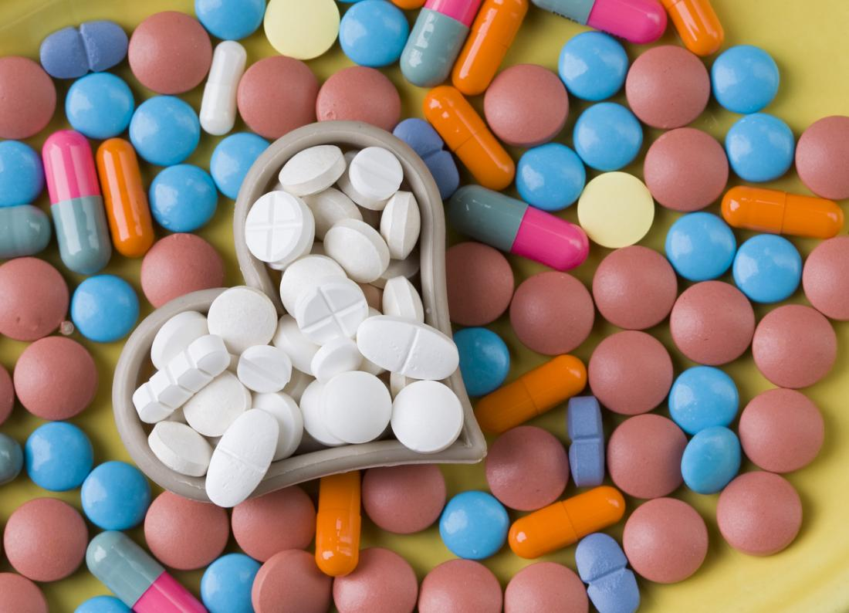
Calcium Channel Blocker Poisoning

Slide 29
CCBs are used in the treatment of hypertension, angina pectoris, cardiac arrhythmias, and other disorders.
These medications are available in both immediate-release and extended-release preparations
The potential toxicity of these agents is substantial, and is often under appreciated by the public.

Slide 30
Pathophysiology
Based on their predominant physiologic effects, divided into two major categories:
  Dihydropyridines: which preferentially block the L-type calcium channels in the vasculature.
  Nondihydropyridines: such as verapamil and diltiazem, which selectively block L-type calcium channels in the myocardium.
The dihydropyridines (including nifedipine, amlodipine, felodipine,nicardipine, nisoldipine, isradipine, and lacidipine) are potent vasodilators that have little negative effect upon cardiac contractility or conduction at standard doses. In contrast, verapamil and, to a lesser extent, diltiazem are weak vasodilators but have a depressive effect on cardiac conduction and contractility.
Dihydropyridine intoxication generally results in arterial vasodilation and reflex tachycardia, whereas diltiazem and verapamil toxicity cause peripheral vasodilation, decreased cardiac inotropy, and bradycardia. However, as the dose is increased, this selectivity can be lost, and dihydropyridine CCBs (including nifedipine and amlodipine) may affect the myocardium and conducting system like verapamil and diltiazem (ie, decreased inotropy and bradycardia).

Slide 31
Pharmacokinetics
Most CCBs are highly protein bound, have a large volume of distribution, and are metabolized in the liver. As the dose is increased, the rate of CCB clearance decreases, prolonging the half-life.
Extended-release preparations slowly release the drug from a matrix to
facilitate once-daily dosing. In overdose, this property makes absorption unpredictable, and prolongs the duration of toxicity.

Slide 32
Clinical Features
History:
  Time of ingestion, as well as the type (to predict toxicity), amount, and preparation(immediate or sustained release) (to determine the appropriate approach to gastrointestinal decontamination) of drug ingested.
  Patients ingesting more than 5 to 10 times the usual dose can develop signs of severe intoxication.
  After resolution of the acute episode, it is important to clarify whether the ingestion was accidental or intentional, and to assess the patient for suicidality.

Slide 33
Physical examination
  Vital sign abnormalities include hypotension, which may be seen in any CCB overdose, and bradycardia, which usually is seen only in verapamil or diltiazem overdose.
  However, bradycardia may also be seen with severe dihydropyridine (eg, nifedipine) poisoning.
  Jugular venous distension, pulmonary crackles, and other signs of heart failure may be noted in some cases.
  Despite hypotension, CCB-poisoned patients may maintain a surprisingly clear mental status, possibly due to the neuroprotective effects of CCBs.
    However, neurologic status may deteriorate precipitously once cerebral perfusion becomes critically limited.

Slide 34
Diagnostic Evaluation
ECG in patients with known or suspected CCB intoxication (PR interval prolongation and any bradydysrhythmia)
A finger stick blood glucose measurement may reveal hyperglycemia, which is caused by inhibition of calcium-mediated insulin release; however, this elevation is rarely clinically significant, except for diagnostic purposes.
Serum toxicology can confirm coingestion of acetaminophen or salicylates, which should be excluded in suicidal patients.
Serum electrolytes, BUN, creatinine, calcium, and glucose concentrations should be assessed.
A chest radiograph should be obtained if there are any signs of pulmonary edema, hypoxia, or respiratory distress.

Slide 35
Management

Slide 36
Initial resuscitation
  Circulation is the main focus of the treatment of CCB exposures.
    Hypotension and bradycardia can be profound and refractory even to maximal treatment
  IV fluids are the initial therapy for hypotension, and atropine the initial treatment for bradycardia, but both may be insufficient.
  CCB-poisoned patients may maintain a clear mental status despite hypotension and bradycardia. However, clinicians need to reassess these patients frequently, as precipitous deterioration is common, and many will
  eventually require intubation and mechanical ventilation.

Slide 37
Approach to the selection of specific therapies
Although it is ideal to institute treatments individually to assess their success or failure, this is often not possible in patients who are severely poisoned with CCBs, especially verapamil or diltiazem.
These patients are frequently moribund on presentation, but even when initially well-appearing may deteriorate rapidly and disastrously
Approaches to therapy are based upon the severity of clinical signs.

Slide 38
Disposition — A patient who ingests or claims to have ingested an immediate-release CCB but remains
asymptomatic after six to eight hours may be considered medically cleared. If the CCB preparation was a
sustained or extended-release preparation, admission and cardiac monitoring for 24 hours is warranted. In the
symptomatic patient, continuous hemodynamic monitoring is required until the patient does not require any
pharmacologic assistance to maintain blood pressure. If multiple agents are being utilized, invasive monitoring
with a pulmonary artery catheter should be strongly considered to help guide therapy. If an intentional
overdose is known or suspected, psychiatric evaluation is needed.

Slide 39

Thanks…

